Slide 1

Apache Cocoon
Dima Ionut Daniel

Slide 2
Contents
What is Apache Cocoon?
Architecture
Components
Core
Pipelines
Web
Transformer
Serializer
Sitemap
XSP
Action
Conclusions
Bibliography

Slide 3

What is Apache Cocoon?
Apache Cocoon is a web application framework built around the concepts of pipeline, separation of concerns and component-based web development.
The framework focuses on XML and XSLT publishing.
The content management systems Apache Lenya and Daisy have been created on top of the framework.

Slide 4
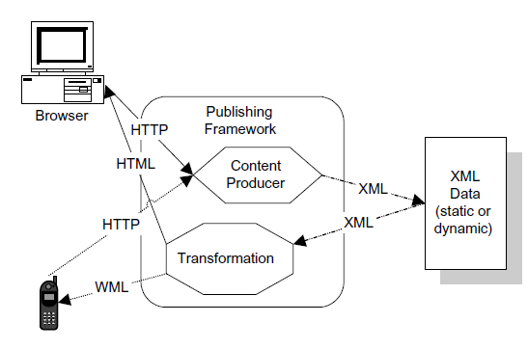
Architecture
Bellow based on HTTP request we can produce HTML or WML(Wireless Markup Language).

Slide 5
Components
Cocoon component are grouped by function:
Matchers: used to match user requests such as URLs or cookies against wildcard or regular expression patterns.
Generators: create a stream of data for further processing(stream can be generated from an existing XML document).
XSP: is an XML Server Page is an XML document containing tag-based directives that specify how to generate dynamic content at request time.
Transformers: take a stream of data and change it in some way.

Slide 6
Components (cont.)
Serializers: turns an XML event stream into a sequence of bytes (such as HTML) that can be returned to the client.
Selectors: offer the same capabilities as a switch statement.
Views: are mainly used for testing. A view is an exit point in a pipeline.
Readers: publish content without parsing it (no XML processing).
Actions: java classes that execute some business logic or manage new content production.

Slide 7
Core
A pipeline is used to specify how the different Cocoon components interact with a given request to produce a response.
A typical pipeline consists of a generator, followed by zero or more transformers, and finally a serializer.
Cocoon automatically transforms documents based on the request context.
It relies on XML and XSLT.

Slide 8
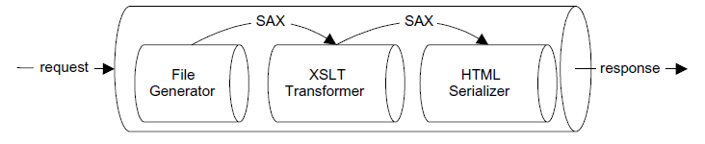
Pipelines
A pipeline is a series of steps for processing a particular king of content.

Slide 9
Pipelines (cont.)
As the request is processed it moves from stage to stage in the pipeline.
Each stage is responsible for a part of the generation or transformation of the content.
Between each stage of the pipeline, SAX events are fired for further customization of the content.
A pipeline can consists of 4 types of steps: generator, transformer, aggregator, serializer.

Slide 10
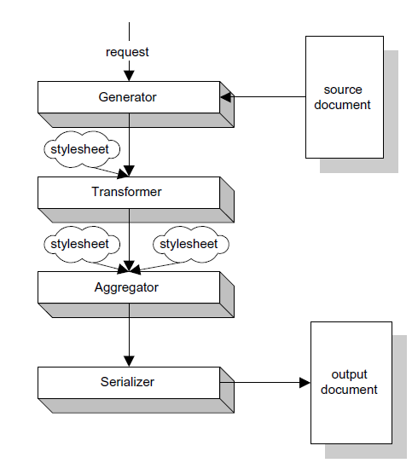
Pipelines (cont.)
The types of processing to which content is subjected is defined in a sitemap.
It's the major configuration document for the publishing framework.

Slide 11
Pipelines (cont.)
<map:match>: sequence of pipeline elements that are executed if the matcher succeeds.
<map:generate>: designates the generator that provides the initial XML content for a pipeline.
<map:transform>: selects the component that transforms the XML event stream.
<map:serialize>: specifies the serializes that takes the XML content of the pipeline and sends it to the result.
<map:select>: contains a sequence of <map:when> and optional <map:otherwise>.

Slide 12
Pipelines (cont.)
<map:act>: executes an action.
<map:redirect-to>: performs an HTTP redirect.
<map:call>: invokes a resource.
<map:parameter>: appears as a child of other pipeline elements.

Slide 13

Pipelines (cont.)
<map:handle-errors>: defines error handler.
<map:mount>: way to include sitemap modules.
<map:aggregate>: defined aggregator which allows the combination of XML sources into a single source.

Slide 14
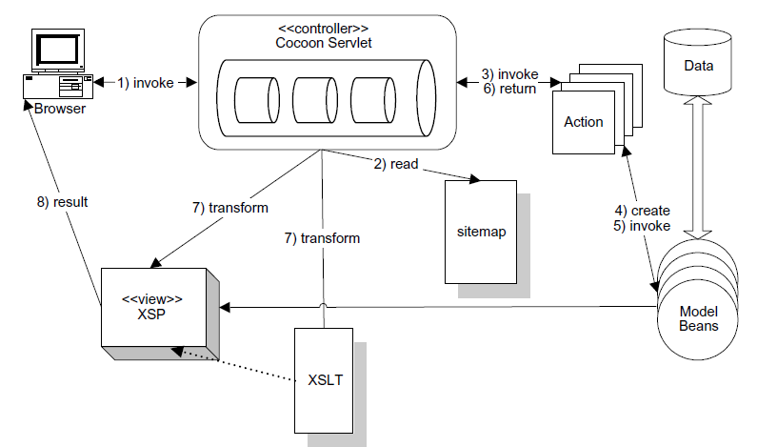
Web
For the web application part the requests are handled by a Cocoon servlet.

Slide 15
Transformer
A transformer in Cocoon is an equivalent to an XSL transformation.
It accepts an XML document (or a stream of SAX events) and generated another XML document(or SAX events).
The simplest transformer is based on the XSLD engine Xalan.
The XalanTransformer applies XSL to the SAX events it receives.

Slide 16
Serializer
A serializer is responsible for generating output from a stream of XAS events.
Cocoon includes serializers for generating HTML, XML, PDF, VRML, WAP.
The simplest of the serializers is the XMLSerializer.
It receives SAX events and returns an XML document.

Slide 17
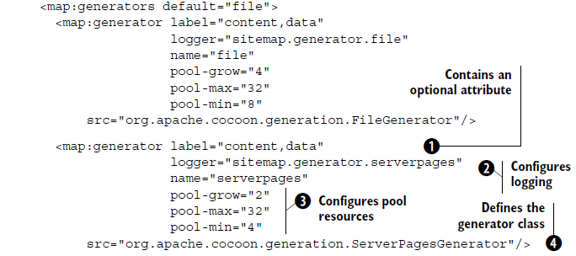
Sitemap
The sitemap is a document that defines all the pipelines, generators and other configuration for a Cocoon application.
It also maps URI to resources.
The sitemap consists of 2 parts: components and pipelines.

Slide 18
Sitemap (cont.)
The label attribute is optional.
The logger attribute specify a different logging mechanism for each component.
The pool attribute are used by a component manager to specify the resource allocation.
The src attribute represents the fully qualified class name of the generator class

Slide 19
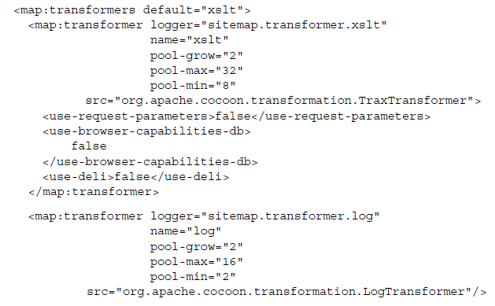
Sitemap (cont.)
Transformers are in the component section and are in the pipeline between the generator and the serializer.
Some transformers have custom configuration associated with them as child attributes.
The custom components are declared in another file: Cocoon.xconf which is the configuration file format for the Avalon meta-framework on which Cocoon is based.

Slide 20

Sitemap (cont.)
Actions are executed during pipeline setup.
If the action fails, the pipeline segment defined inside the action will not execute.
Actions are the prime execution context in Cocoon.

Slide 21
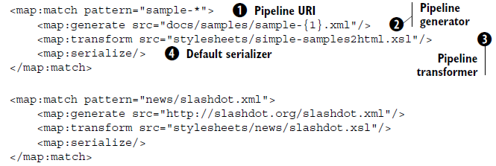
Sitemap (cont.)
The second part of sitemap consists in pipeline definitions.
Pipelines specify how the processing of content is done.
Pipelines consists in generator, 0 or more transformers and serializer.
The invocation of a pipeline depends on a URI mapping either of a single document or by extension or wildcard.

Slide 22
Sitemap (cont.)
The pipeline matches the URI "sample-*".
The generator is a document located at docs/samples/sample-{1}.xml where {1} token is part of the URI handled by the asterisk.
The transformation is the standard transformation for sample documents to HTML.
The serializer is the default serializer.

Slide 23
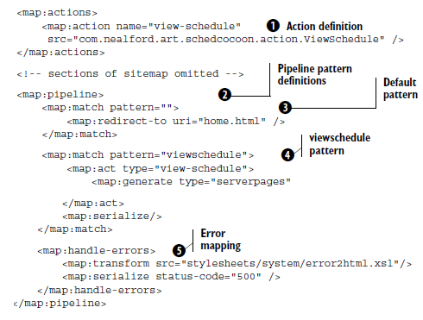
Sitemap (cont.)
The first step in a Cocoon project is the creation of the sitemap.

Slide 24
XSP
Cocoon has the concept of XSP(Extensible Server Pages), similar to JSP but use a stricted XML syntax.
The pages are XML pages, not HTML.
The XSP pages are not tied to java.
An implementation for JavaScript exists in XSP.

Slide 25
XSP (cont.)
<xsp:page>: root element of an XSP page.
<xsp:structure>: container for <xsp:include> elements.
<xsp:include>: imports type definitions.
<xsp:logic>: logic implementation of an XSP.
<xsp:expr>: invokes logic in <xsp:logic>.

Slide 26
XSP (cont.)
<xsp:element>: allows the creation of dynamic elements in the output XML.
<xsp:attribute>: child of <xsp:element>.
<xsp:comment>: used to create a comment in the XSP output.
<xsp:pi>: allows creation of processing instructions.
<xsp:content>: can be used inside an <xsp:logic> element to insert Java code.

Slide 27
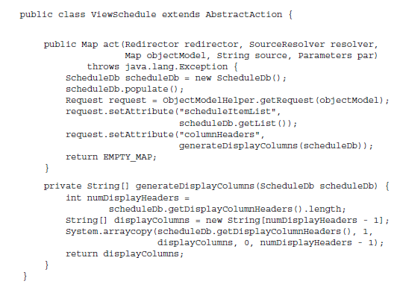
Action
The action is similar to an Struts action or other web framework that uses the Command design pattern
The action classes extracts AbstractAction Cocoon class and overrides the abstract model act().
The ObjectModelHelper class returns an instance of the Cocoon request object.

Slide 28
Conclusions
Cocoon is a very complex framework.
Cocoon is a MVC web framework.

Slide 29

Bibliography
https://en.wikipedia.org/wiki/Apache_Cocoon
Manning - Art Of Java Web Development
Cocoon: Building XML Applications

